Slide 1
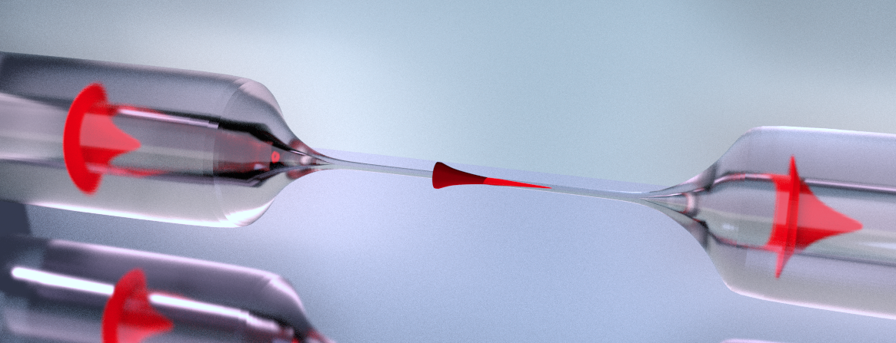
Observation of Multimode strong coupling of laser-cooled atoms to fiber-guided photons
Martin Blaha, Aisling Johnson, Alexander Ulanov
Jürgen Volz, Philipp Schneeweiss and Arno Rauschenbeutel
Notes:
Pacing ganz wichtig :d

Slide 2
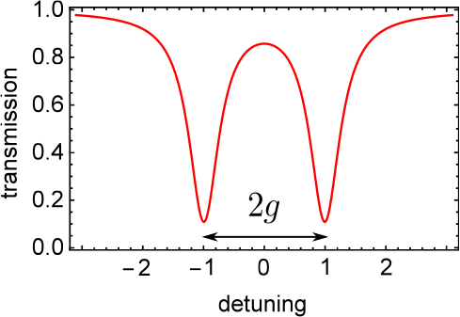
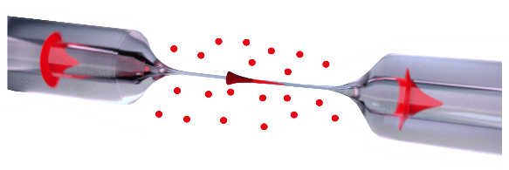
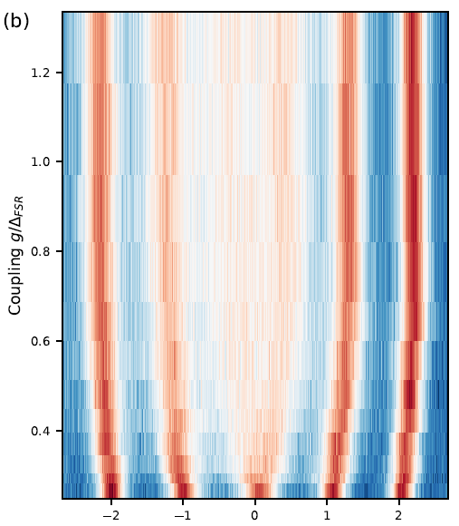
Outline
Multimode Strong coupling in CQED
opt. Nanofibers and Fiber-ring resonator
Measurements and Observations

Slide 3
Introduction
Multimode Strong coupling in CQED
opt. Nanofibers and Fiber-ring resonator
Measurements and Observations

Slide 4
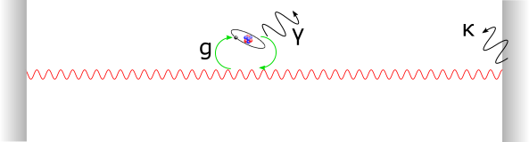
Cavity QED
Singlemode CQED
Strong coupling:
Collective coupling →

Slide 5
Multimode QED
Multimode CQED
Standard approach → tuning interaction via transverse modes
Our approach → Strong coupling to many resonator modes
g > FSR, atoms emit into different cavity modes
Strongly coupled in a single round-trip “Superstrong coupling”
D.Meiser, P. Meystre, PRA (2006)
→ Photon modes interact via the atoms
→ Atoms and field don’t interact instantaneously, new dynamics
Overcome some limits of cavity QED with one mode

Slide 6
Singlemode QED
Mode splitting of single mode cavity
→ Strong coupling

Slide 7
Multimode QED
→atoms interact strongly with many resonator modes
→ experimentally accessible spectrum
See Sundaresan et al., PRX 5, 021035 (2015)
Splitting and pushing of several modes
→ Multimode strong coupling

Slide 8
Multimode Strong coupling in CQED
opt. Nanofibers and Fiber-ring resonator
Measurements and Observations

Slide 9
Key Aspects
Optical Nanofiber for enhanced coupling
Long Resonator for low FSR
Length – independent coupling strenght
Notes:
ONF for evanescent field coupling
Long resonator for small FSR
Independent coupling of length, hence no loss of g but increase with atoms

Slide 10
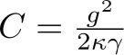
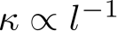
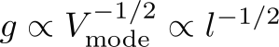
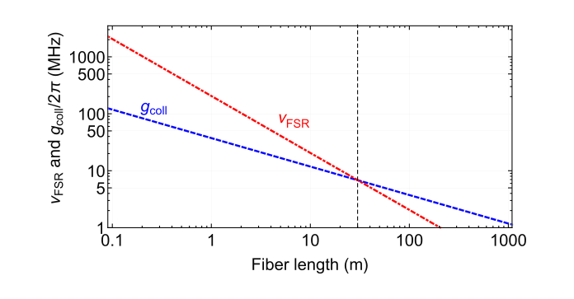
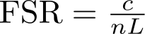
How to reach g > FSR
Length dependence of resonator parameters
Single atom cooperativity
,
→ Increase l (decrease FSR) at will (almost)
Multimode
Accessible with:
l ~ 30 m
N ~ 300 atoms
●
Schneeweiss et al., Opt. Lett. 42, 85 (2017)

Slide 11

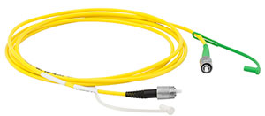
Fiber ring resonator
Optical Nanofiber
30m fiber on a spool
Adjustable beam splitter

Slide 12
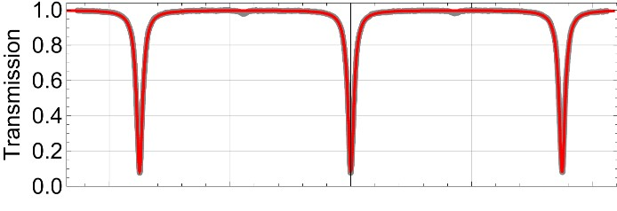
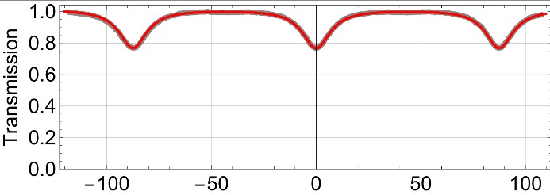
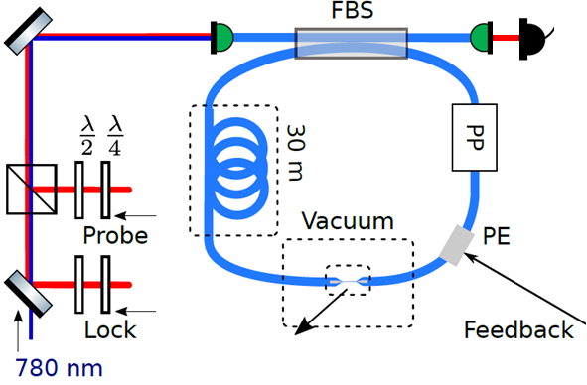
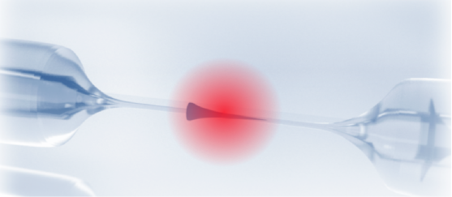
Implementation
critically coupled
over- coupled
Single photon detector
Piezo for locking
Passively insulated

Slide 13
Multimode Strong coupling in CQED
opt. Nanofibers and Fiber-ring resonator
Measurements and Observations

Slide 14
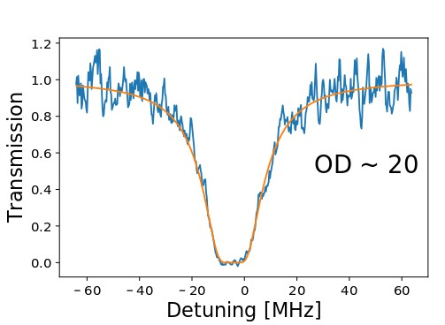
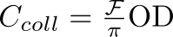
Interfacing the nanofiber with atoms
Magneto optical trap
→ reservoir of cold Cs atoms
Transmission spectroscopy → collective coupling
Set resonator to fully overcoupled → single round-trip of light
From
OD = 17.9
→ Multimode strong coupling regime

Slide 15
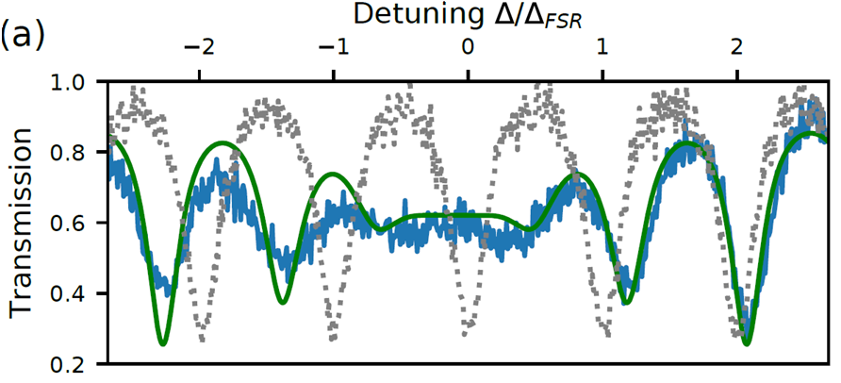
Transmission Spectrum
Set resonator to critically coupled
Transmission spectroscopy → 1ms probing pulse with frequency scanned
Resonator with atoms
Empty resonator
Theoretical prediction for g = 10 MHz

Slide 16
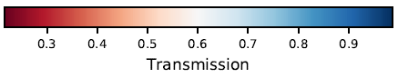
Spectrum
Vary g via the OD by tuning the MOT-nanofiber overlap
Transmission spectroscopy → 1ms probing pulse with frequency scanned
Multimode-
strong coupling regime
OD/coupling increases
Strong coupling regime

Slide 17
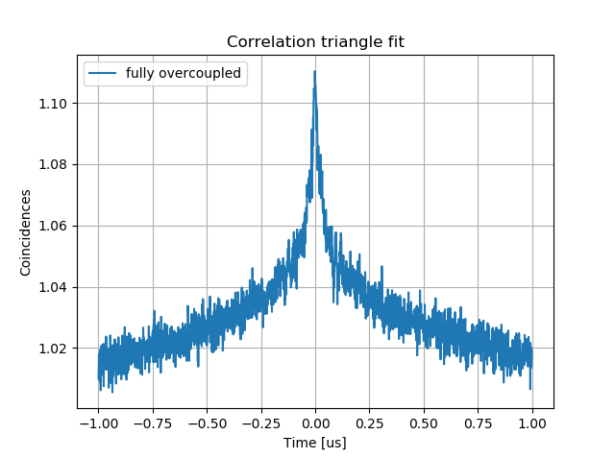
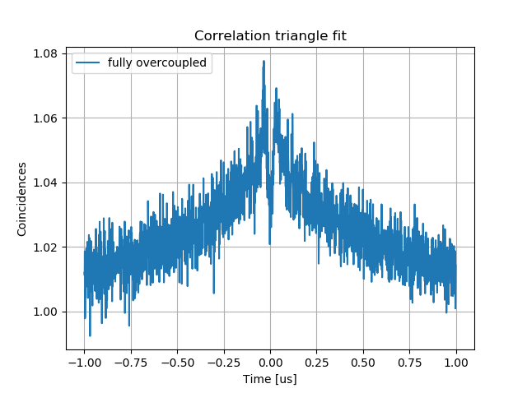
g(2) Measurements
Observe non-markovian behaviour of atom-resonator system
Investigate Nr of atoms conributing to the signal
Low OD case
Fully overcoupled regime → external excitation
Collection of fluorescence photons at the output
See K.P.Nayak et. al., Phys. Rev. A 79 (2009)
J.A.Grover et. al., Phys. Rev. A 92 (2015)

Slide 18
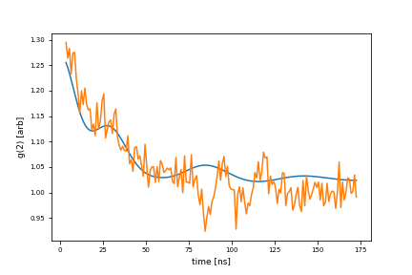
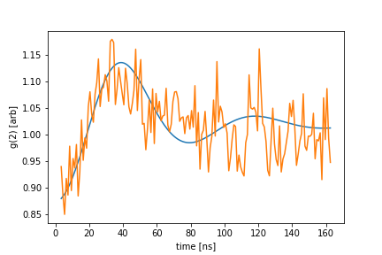
g(2) Measurements
OD per atom ~ 0.05
“effective” atom number for multimode strong coupling ~ 400

Slide 19
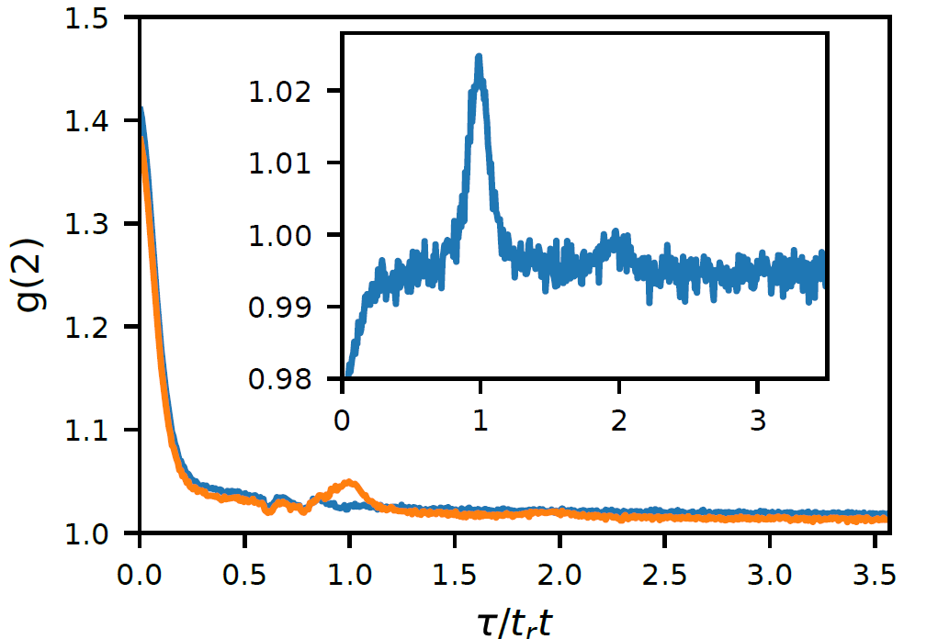
g(2) Measurements
High OD case
“effective” atom number for multimode strong coupling ~ 400
Comparision between critically coupled and overcoupled resonator
Revivals at roundtrip times
→ Photons travel as a pulse and thus couple to several resonator modes

Slide 20
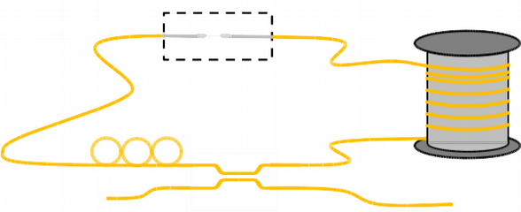
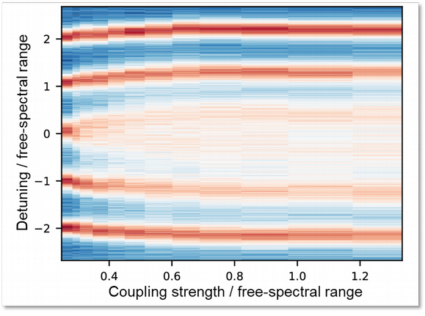
MMSC Conclusion
Nanofibre ring resonator
Combining nanofibre quantum interface and fiber ring resonator
→ entering a new regime of CQED Versatile setup
●
●
Study of multimode strong coupling
Coupling strength exceeds free-spectral range Observation of the transition:
“standard“ → multimode strong coupling
●
●

Slide 21
Outlook
Next experimental steps
Trapping atoms in evanescent field of the nanofiber
Optimizing resonator finesse (reduce linewidth to 100 kHz)
And then?
“non-Markovian”
new type of photon-resonator dynamics
New types of entangled states, photonic info processing...
Taylor interaction range between atoms
Self-organisation

Slide 22
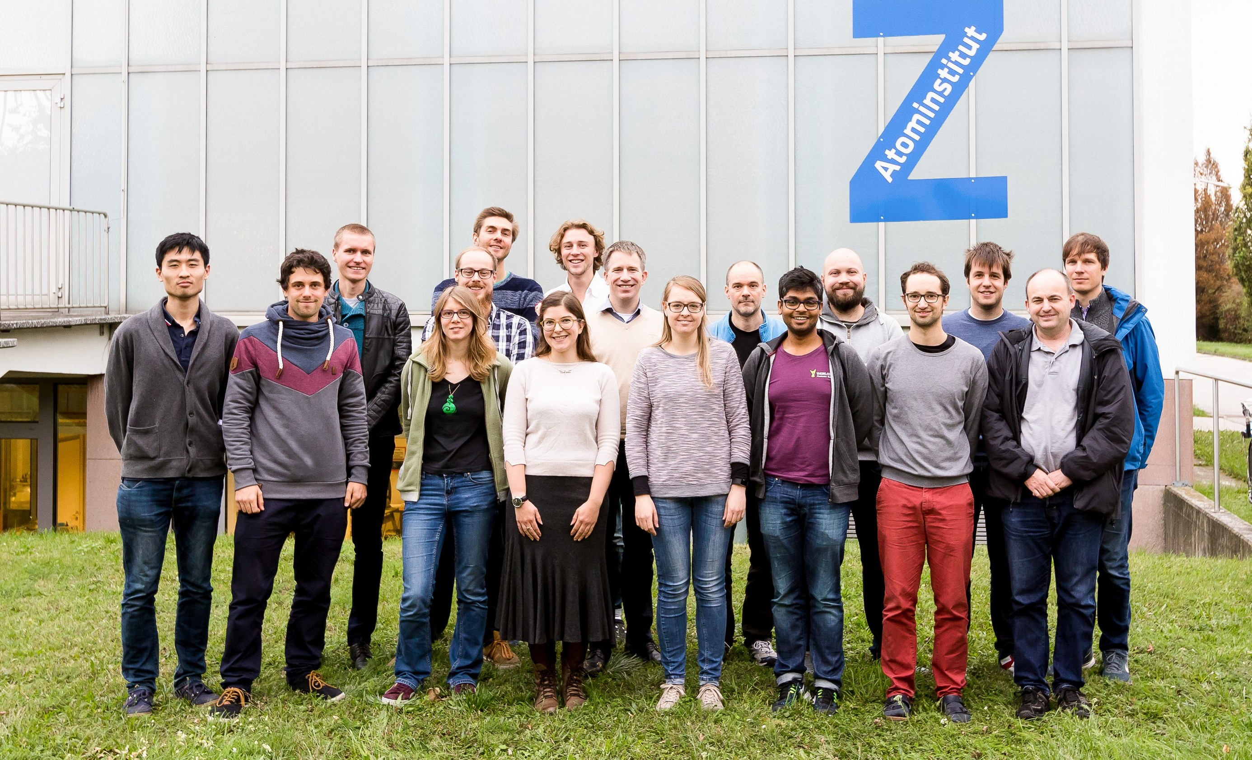




Thank you for your attention
A. Ulanov _{A. Johnson}
A. Rauschenbeutel
P. Schneeweiss
J. Volz
www.nanofiber.at

